Slide 1
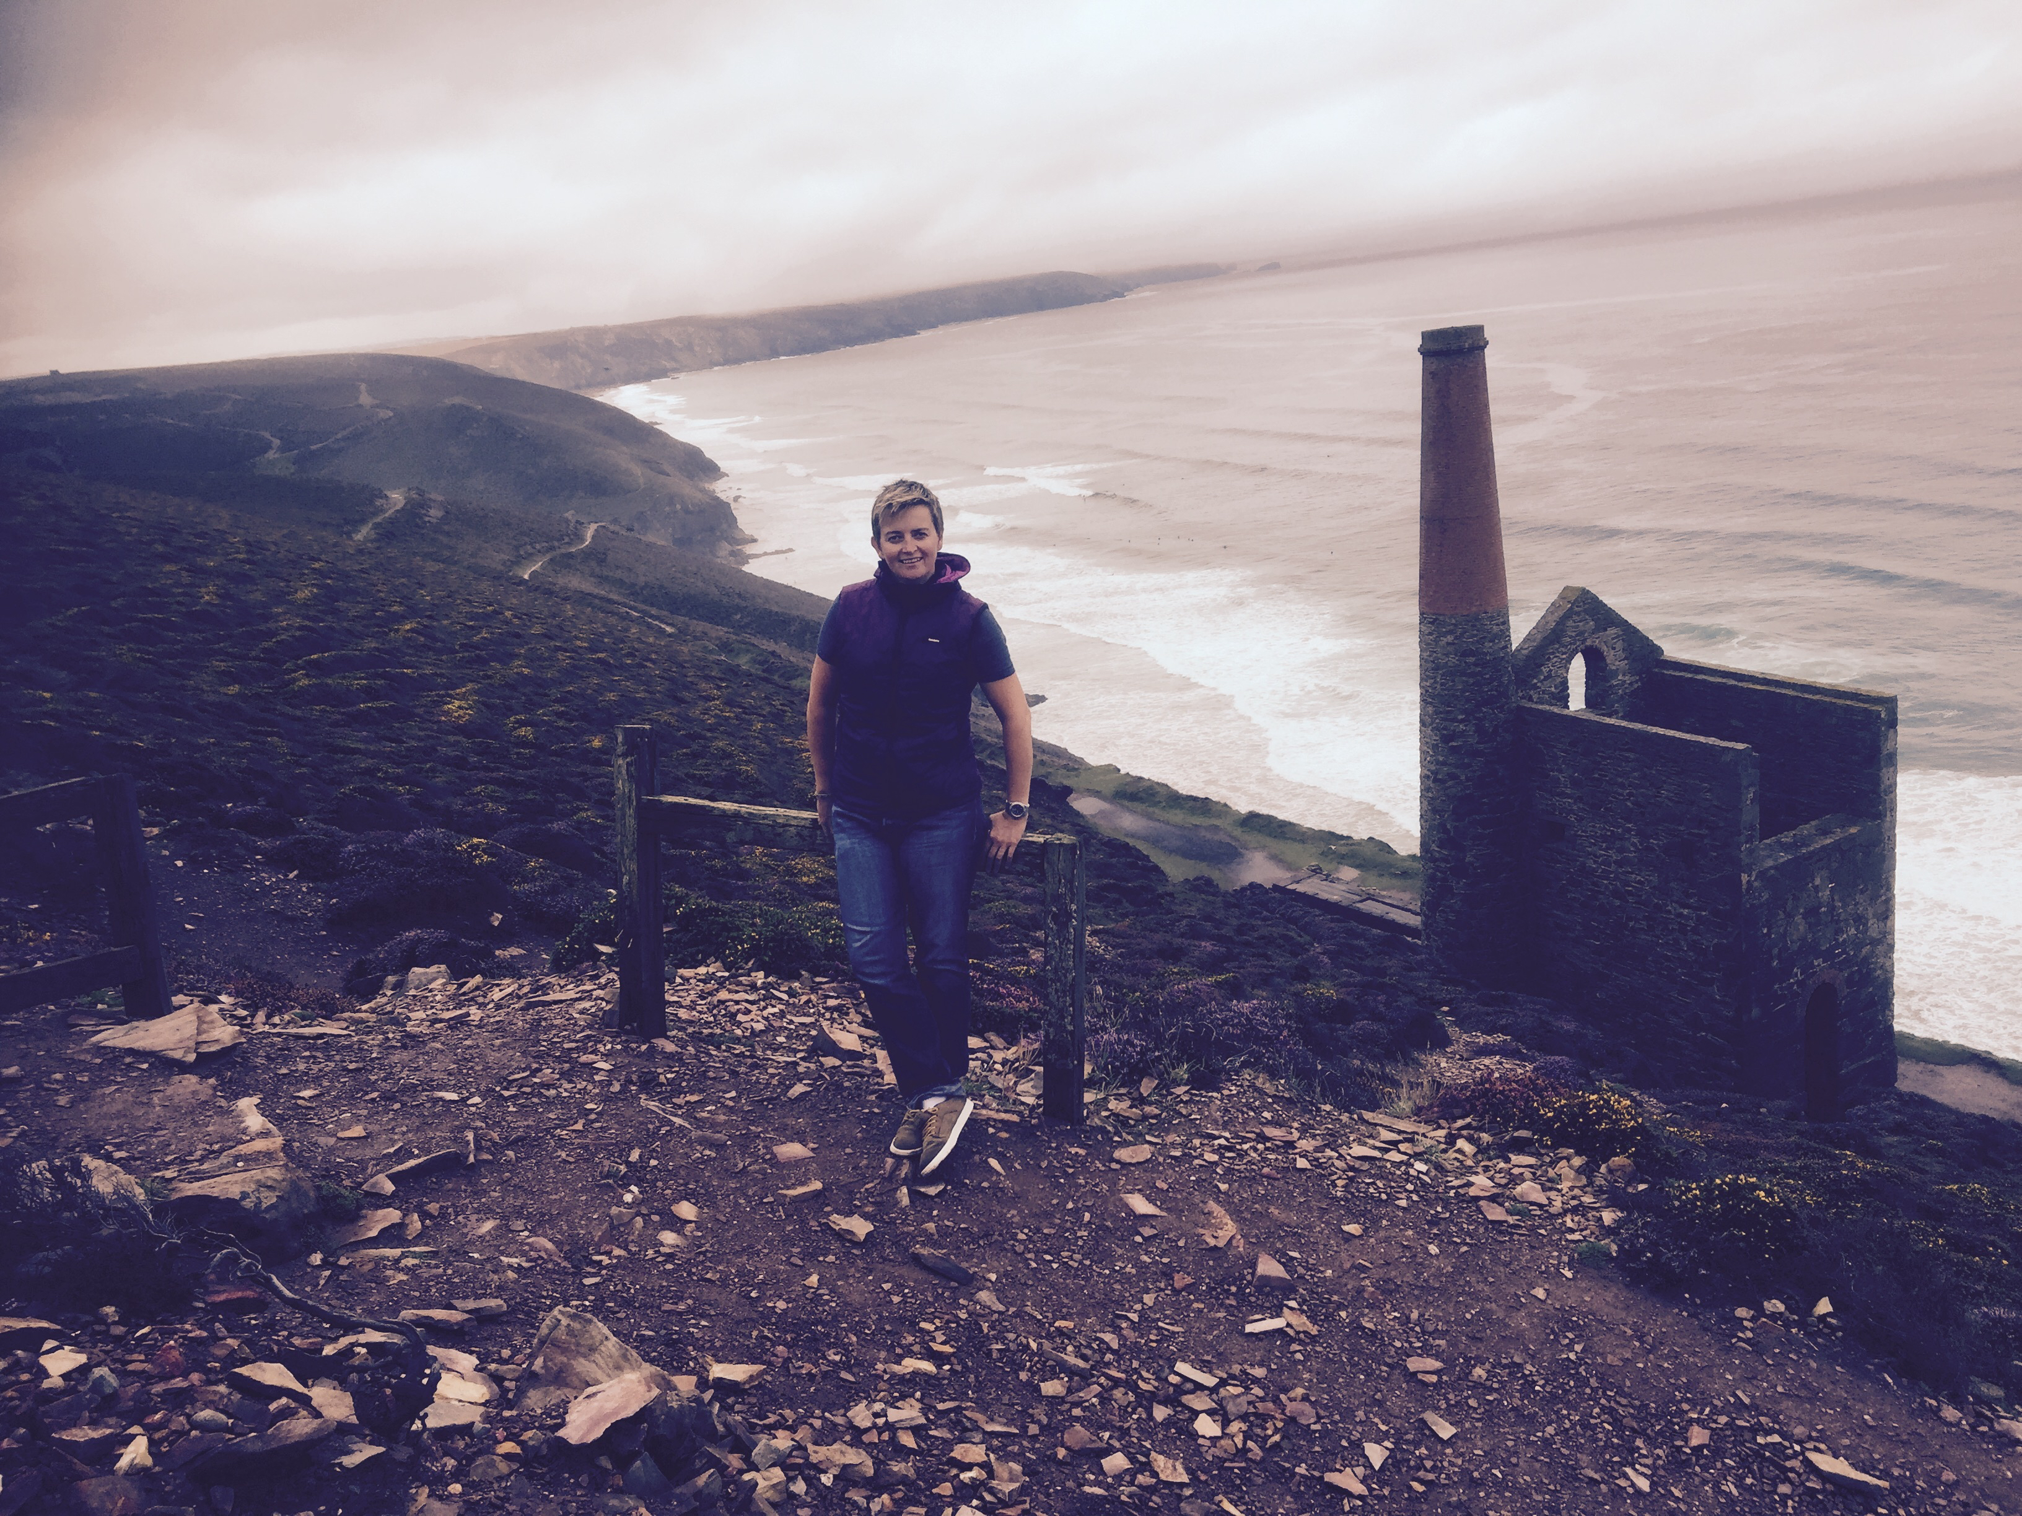
Karen M Hoyle
Author – The Adventures of Austin The Cornish Miner
Book 1: The Rescue of the Dweeble Stone
Book 2: The Morgawr and The Bad Knockers
BOOK 3: THE BELL OF LYONESSE

Slide 2
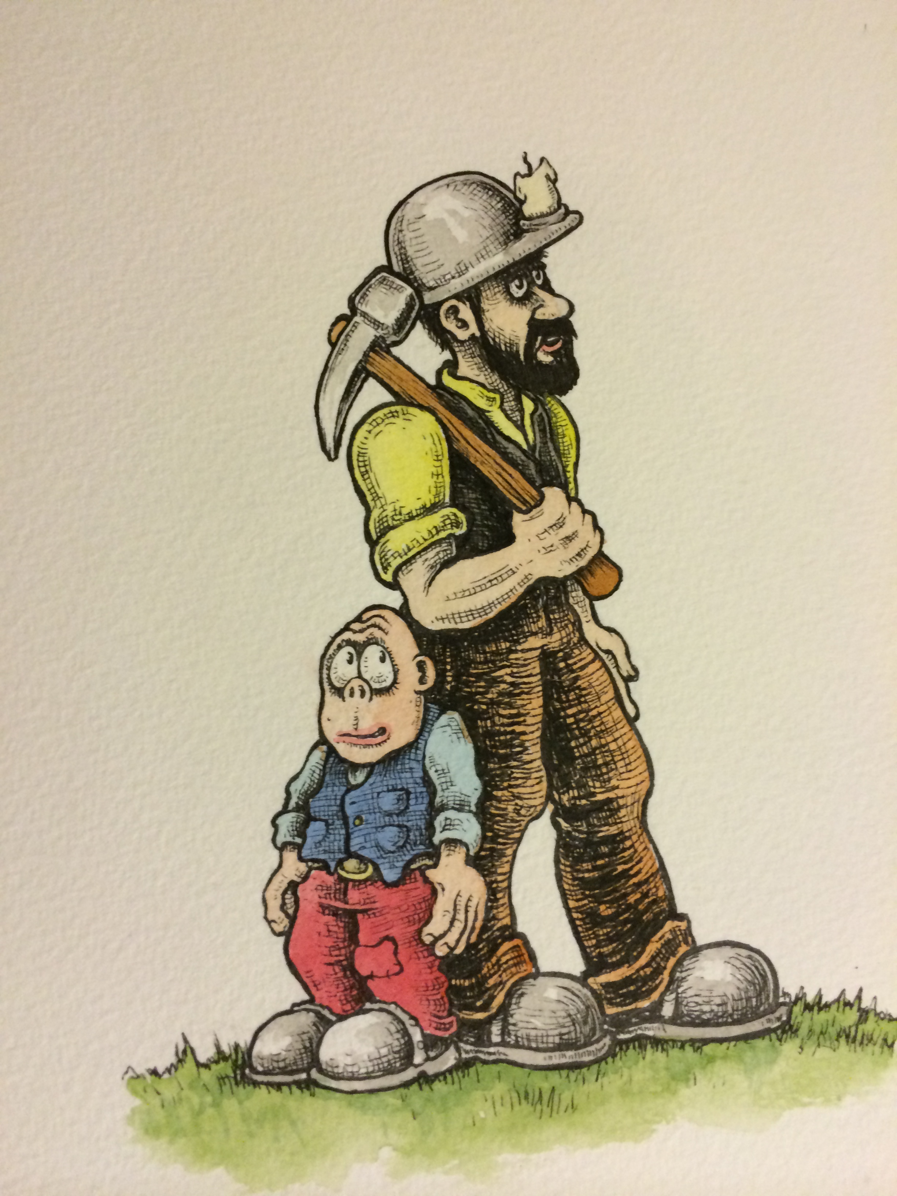
Meet the Characters - Austin

Slide 3
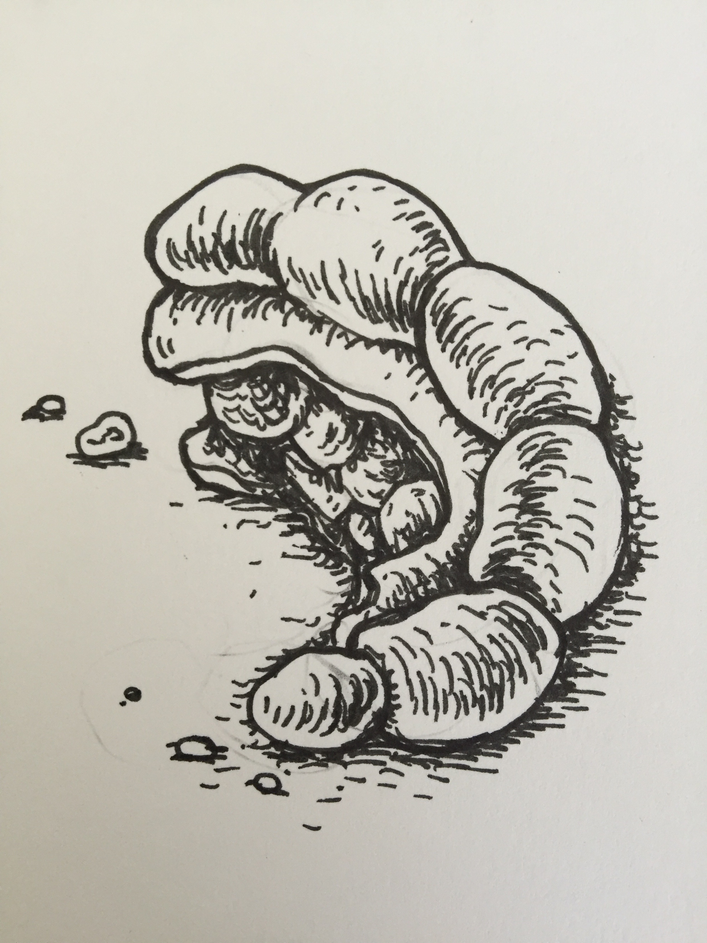
Meet the Characters - Deffler

Slide 4
Meet the Characters – Maggie Farenworth-Fopp

Slide 5
Meet the Characters – Patrick the Fisherman

Slide 6
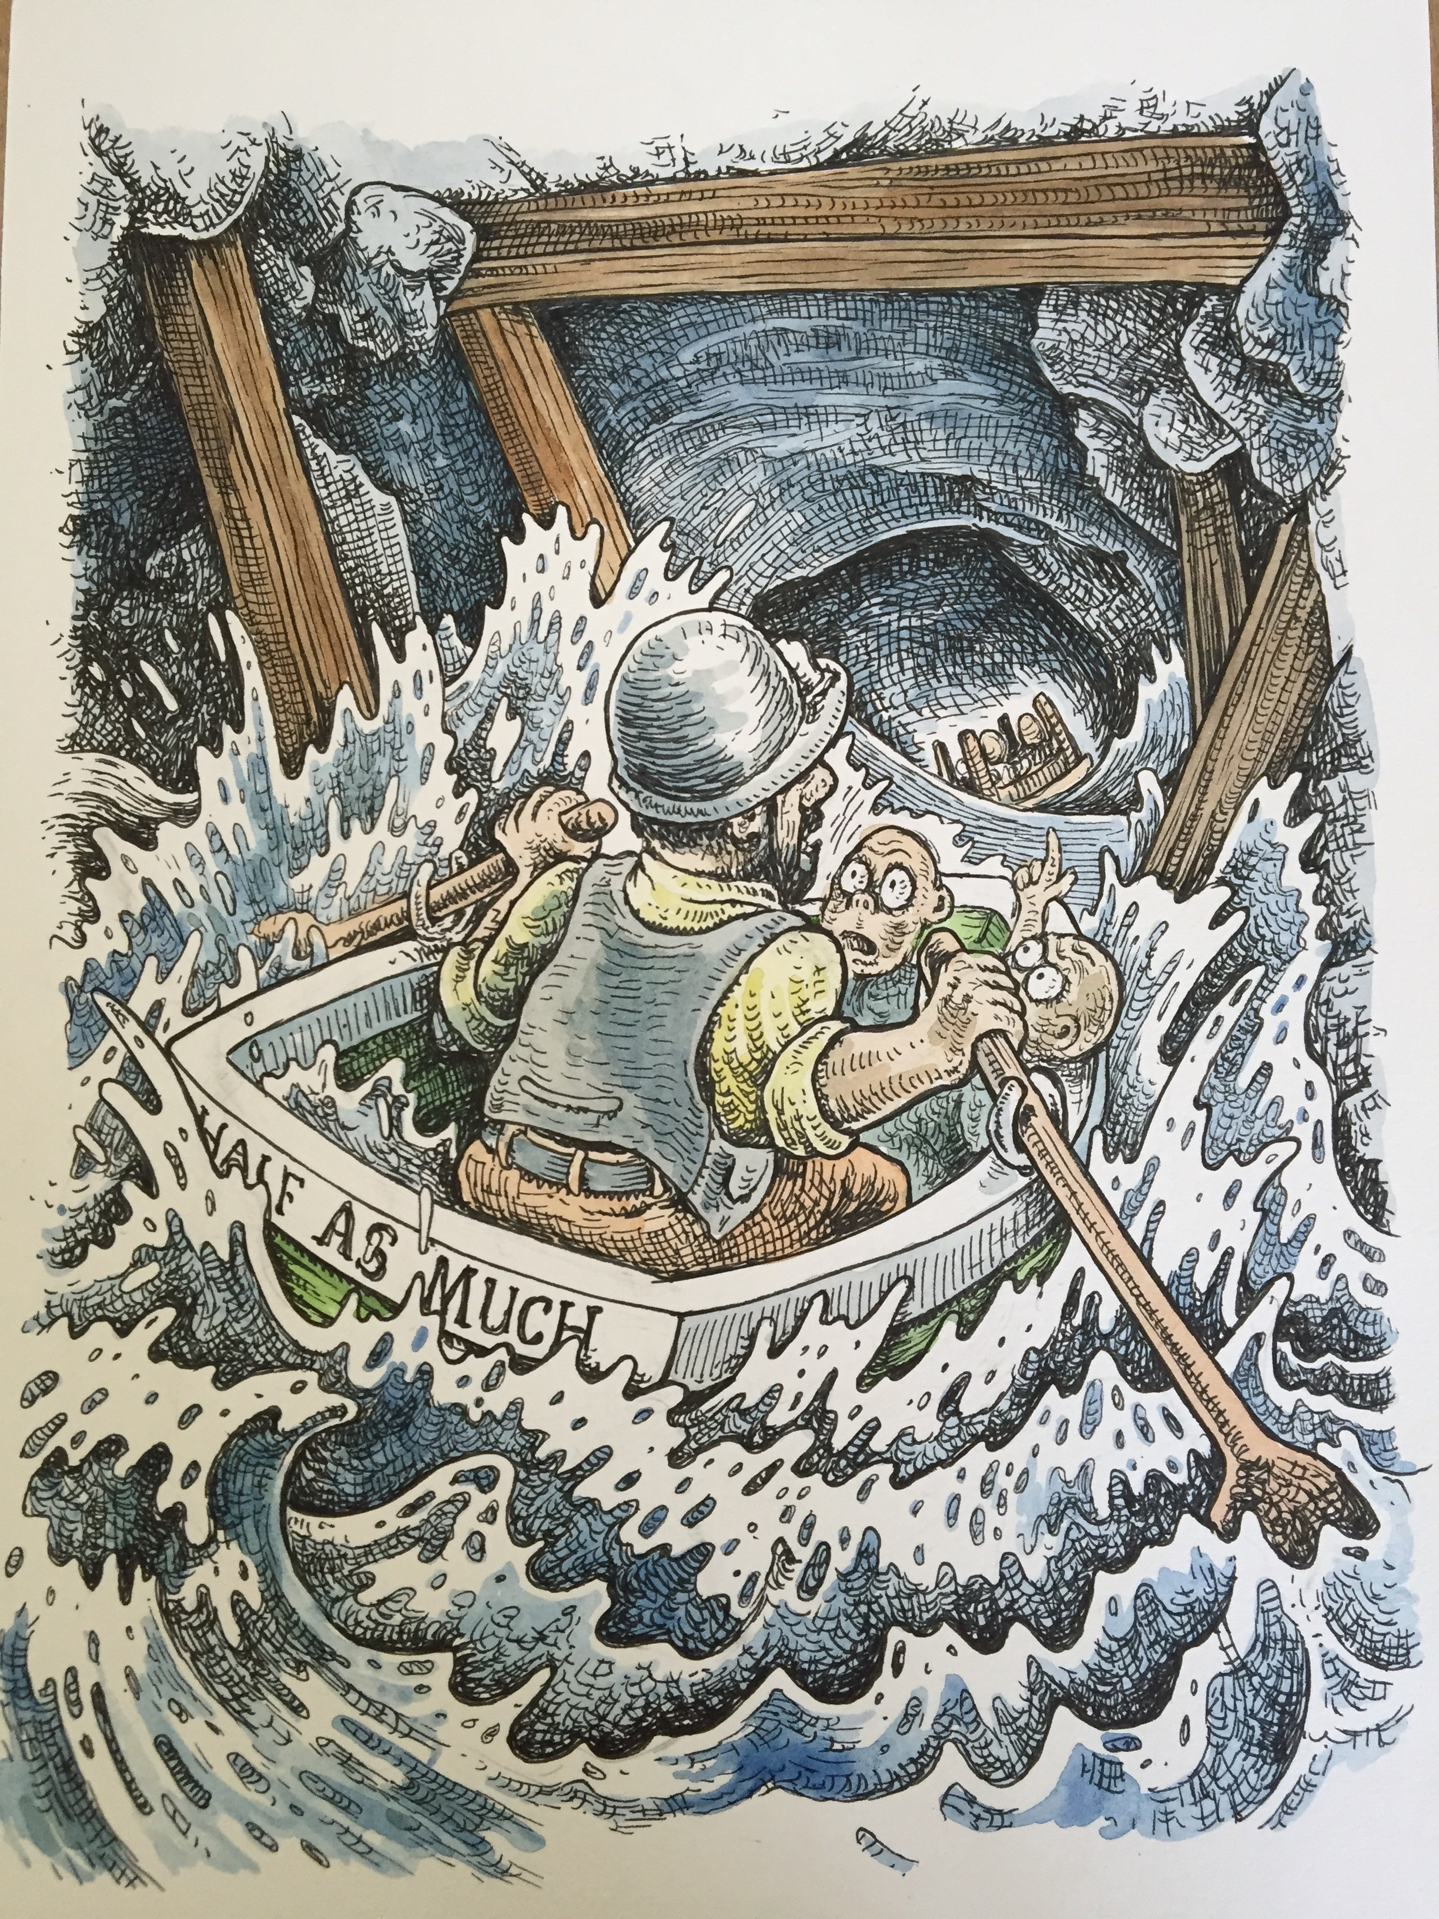
Meet the Characters – Bramble

Slide 7
Meet the Characters – Marky and Greggor

Slide 8
Meet the Characters – The Morgawr

Slide 9
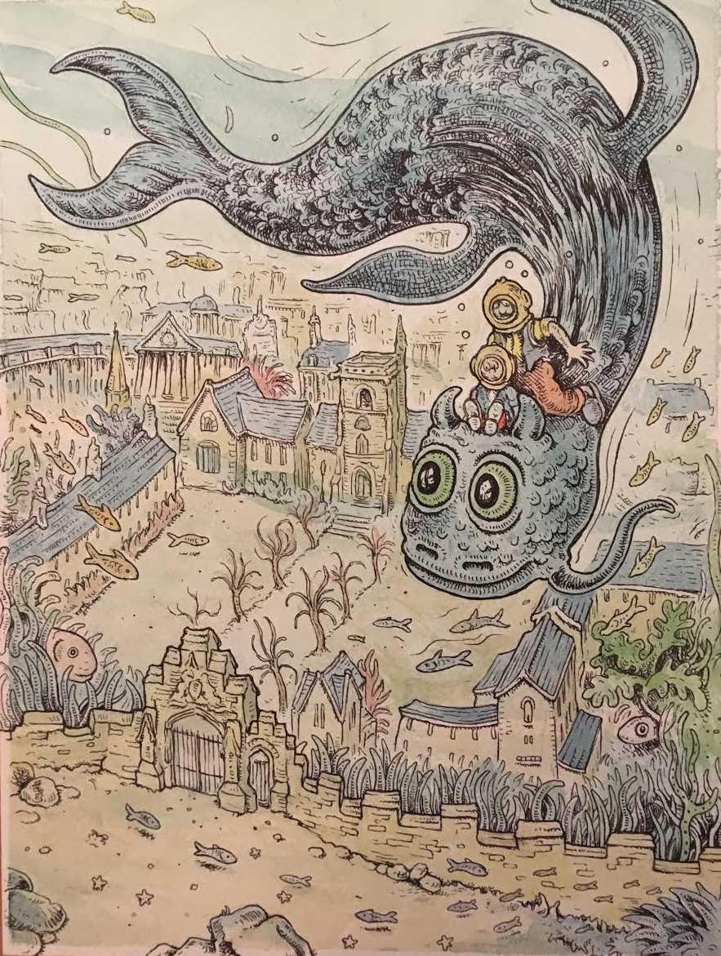
The Underwater City – Lyonesse

Slide 10
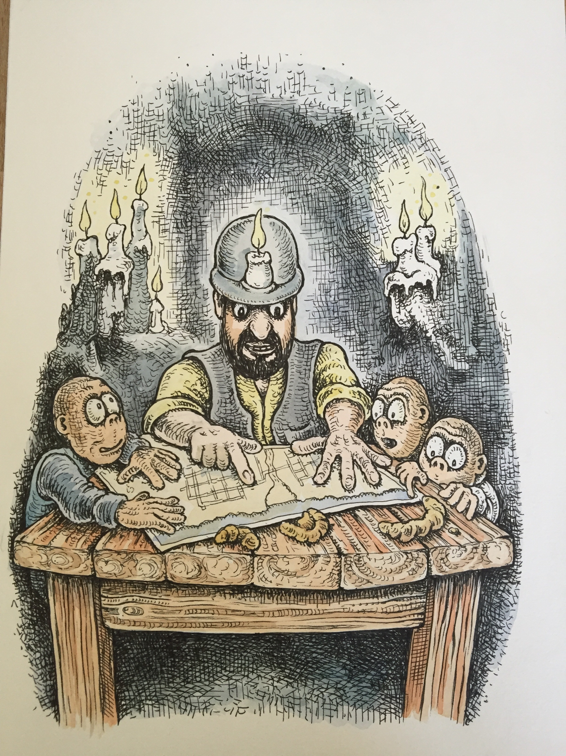
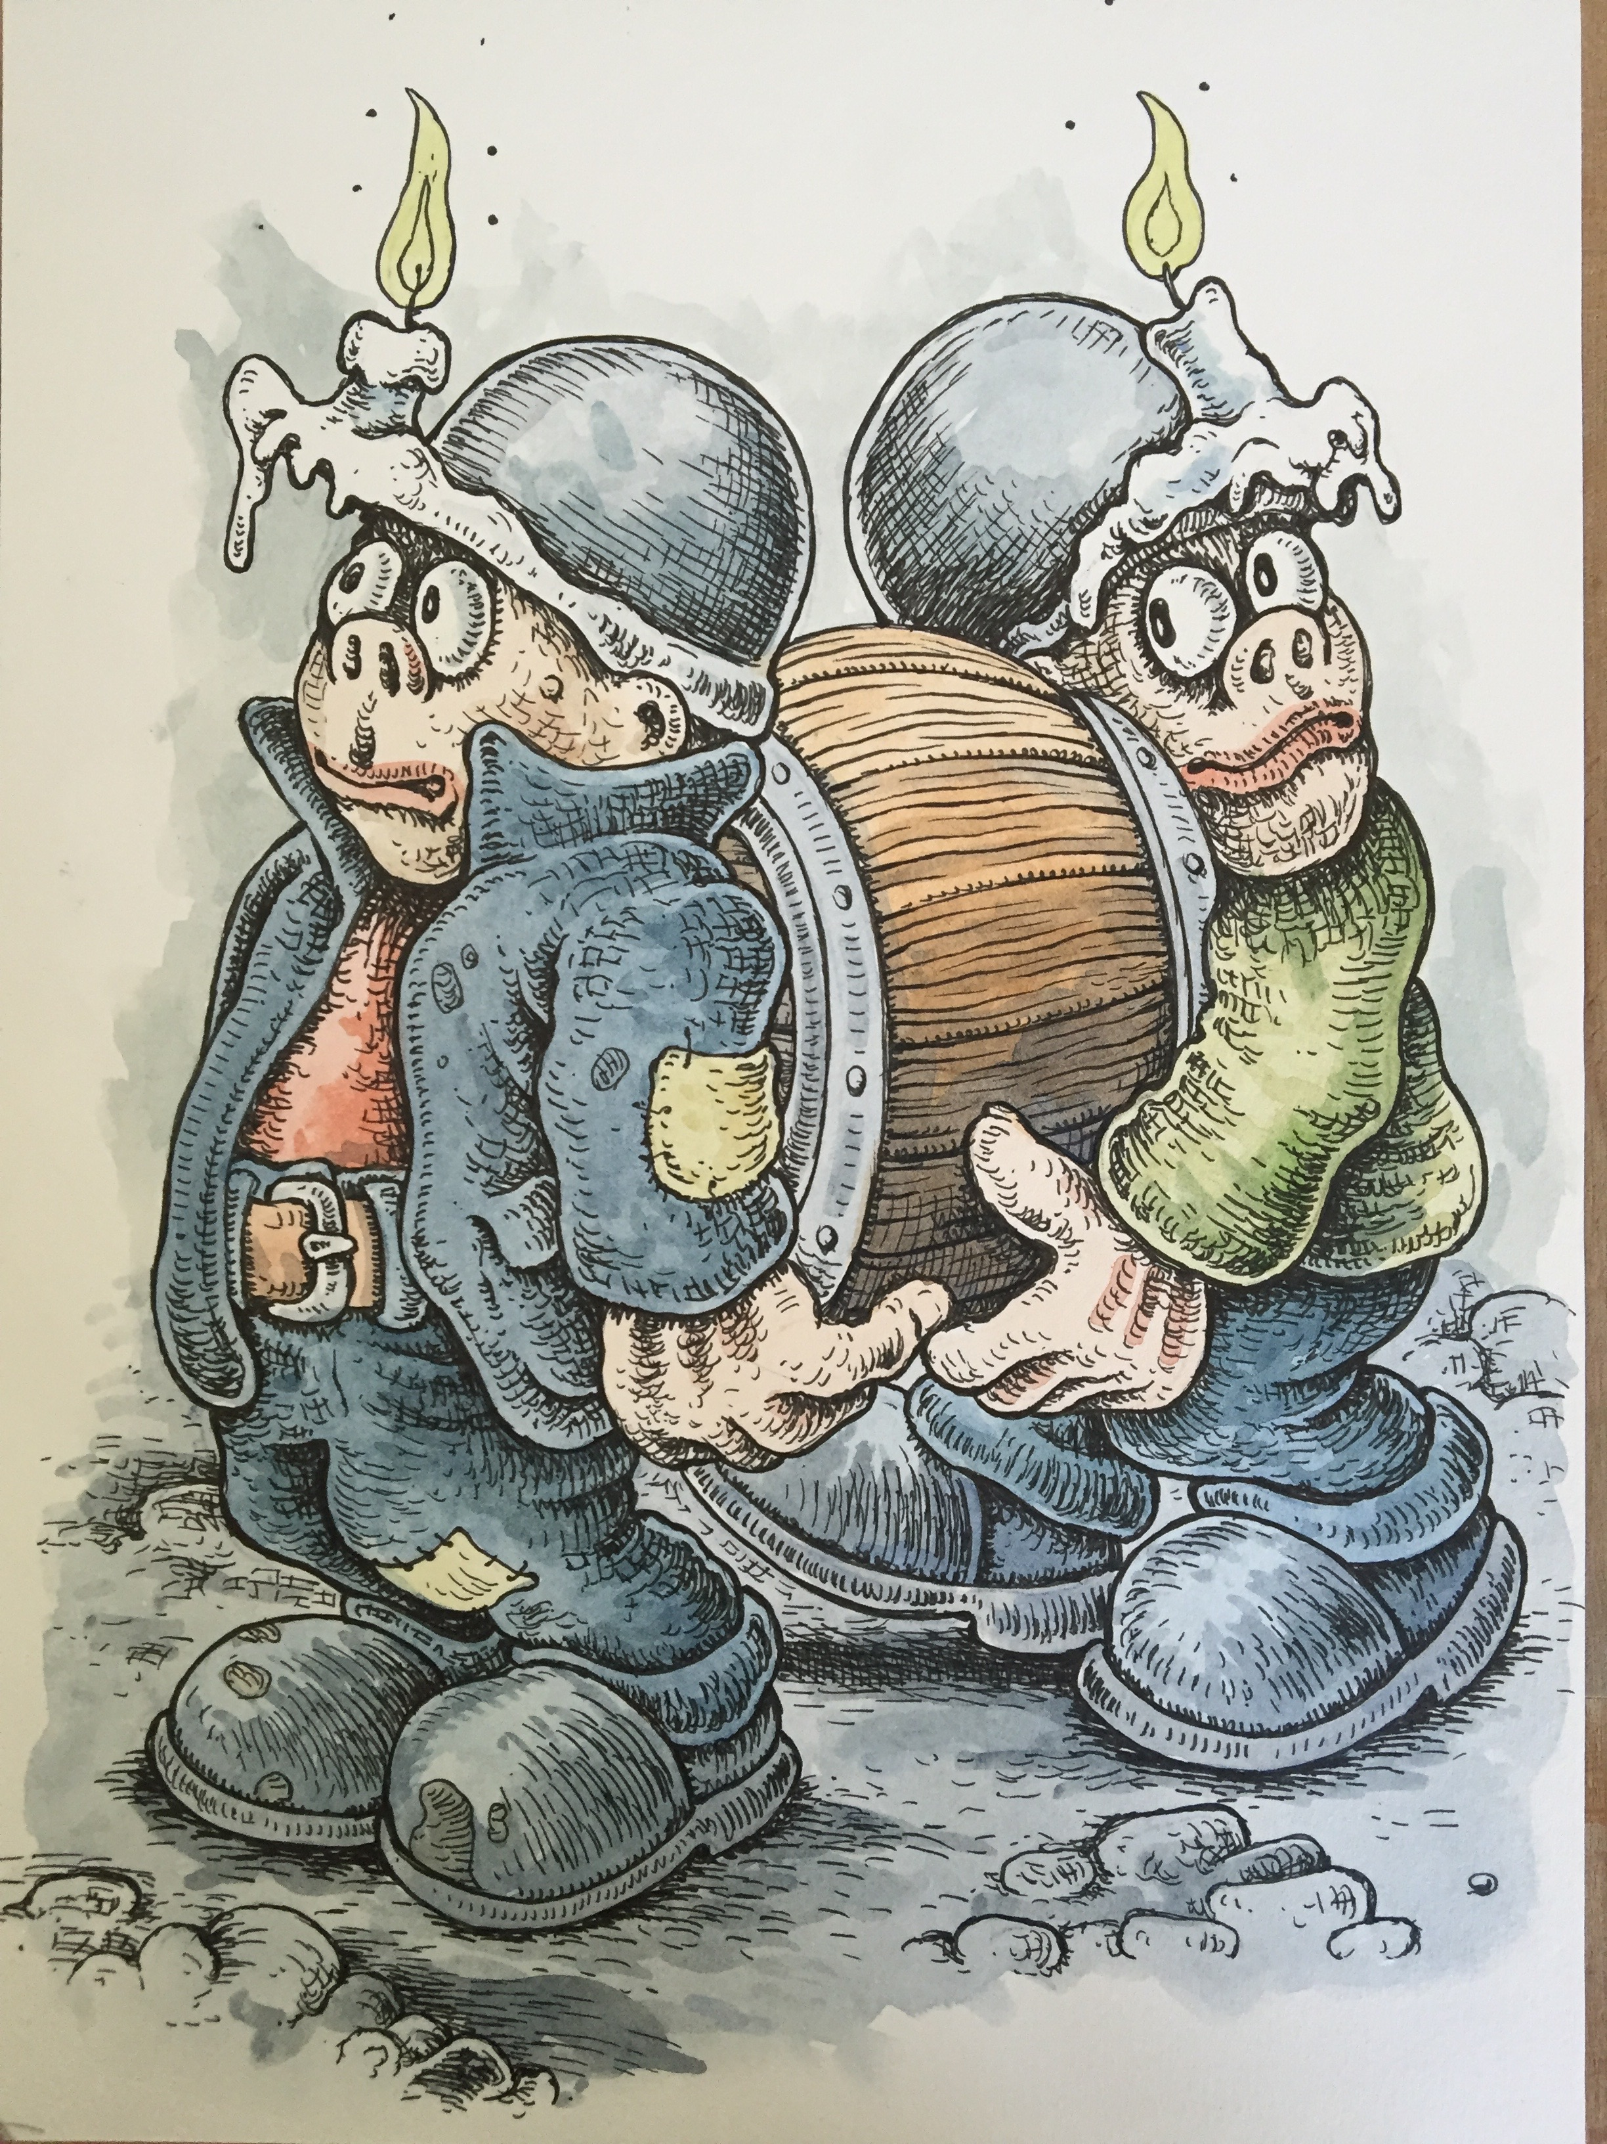
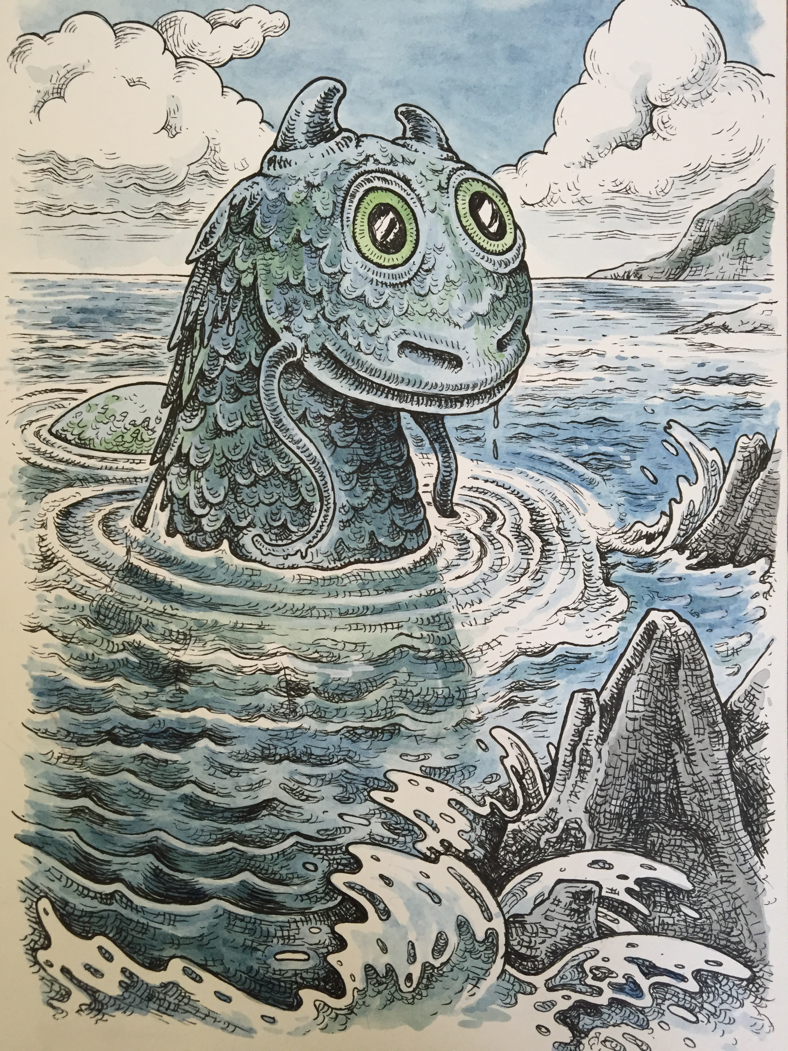
Time to Read

Slide 11
Thank you!

